Slide 1
Counting the costs: the diverse impact of the pandemic in sub-Saharan Africa
Presentation by:
Dr. Chukwuka Onyekwena

Slide 2
Introduction: Pre-existing vulnerabilities
Most countries in Africa met the crises in a weak position.
A host of pre-existing vulnerabilities signaled an impending disaster of massive scale.
The region was battling with socio-economic challenges: rising debt; huge health infrastructure gaps; weak governance and health systems; unemployment and informality of labour; inequality and high poverty incidence, among others.
However, the health effects (mortality & mobility) of COVID-19 have been relatively limited.

Slide 3
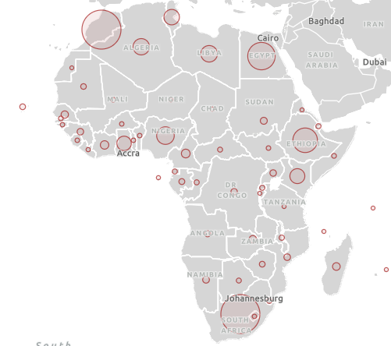
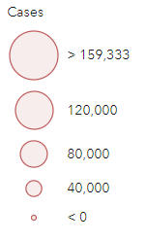
Health effects: Big Picture
Total reported cases in Africa as of Oct. 31, 2021: 6,075,922.
South Africa has reported by far the highest number (2,921,886), followed by Ethiopia (362, 335), (Kenya 252 672) and Nigeria (210, 295).
Total reported deaths: 150,052
South Africa (89,163), Ethiopia (6. 358), Kenya (5 ,257), and Nigeria (2, 856)
Although devastating, COVID has seen a relatively lower incidence level in African countries than in other region:

Slide 4
Economic and social costs
While the lockdown measures where effective in curbing the spread of the virus in Africa, they resulted in severe economic consequences in the region
Restrictions to movement led to a general halt in economic activities- a disruption in the income of workers in the predominantly informal sector (66 percent of total employment in sub-Saharan Africa), who rely on small daily earnings.
These workers in the gig economy in Africa have very limited savings to ease consumption, and thus the lockdown became a threat to their livelihoods.

Slide 5
Economic and social costs contd.
As a result of COVID-19 pandemic, Africa was hit by its worst economic recession in half a century, after contracting by 2.1 percent in 2020.
The economies that were most significantly hit include tourism-dependent economies (-11.5%), oil-exporting economies (-6.2%), and other resource intensive (-4.7%).
Weakened macroeconomic fundamentals: Inflation rose to 10.2%, Significant currency depreciations, fiscal deficits doubled to 8.4% of GDP, leading to increased debt burdens – 10-15 % increase.
About 30 million Africans were pushed into extreme poverty in 2020 as a result of the pandemic and it is estimated that about 39 million Africans could fall into extreme poverty in 2021 (AEO, 2021)

Slide 6
Economic policy responses of African govts.
Response | Limitations
1. Fiscal policy: economy-wide and sectoral interventions using taxation/subsidy, public expenditure and deficit-financing instruments. Emergency budget support for the health sector and the scaling up of social protection for vulnerable households | Limited fiscal space – fiscal stimulus has been small: 1-2% of GDP. High debt levels and weak revenue flows Absence of a social register Low financial & digital inclusion
2. Monetary and macro-financial policy: Expansionary monetary policy- increased money supply through OMO and quantitative easing. Central banks providing medium/long-term loans or grants to businesses or households | Managing the trade-off between growth-enhancing policies and inflation Weak financial markets make the application of monetary policy difficult
3. Exchange rate policy: Disruptions in foreign exchange earnings and the oil price crash worsened foreign reserves. Some countries (like Nigeria) had to depreciate their currency. | Exchange rate policy has not been effective, especially in cases of high volatility

Slide 7
Prospects: Post-COVID ERA
The COVID-19 trajectory (number of new cases) has continued to fall in the African region. Recovery rate of 94%; Only 10 countries experiencing a resurgence; post-Covid era in sight?
Economic challenges will linger on: Debt sustainability, Increases in extreme poverty, declines in trade, FDI, and remittances.
Africa is still vulnerable to future shocks

Slide 8
Conclusion: Policy recommendations
African governments need to take concrete and practical steps towards diversifying their economies to limit their exposure to commodity price shocks. The pandemic should stimulate efforts to move away from commodity dependence, particularly on oil extraction, to sectors which build and strengthen productive capacities, create jobs, and generate non-oil revenues.
Governments in the region need to strengthen their public financial management by building and managing fiscal buffers to cushion the effects of commodity revenue shocks. Fiscal responsibility mechanisms should be enforced and backed by law, to limit wasteful expenditure and reckless accumulation of debt.
Provide incentives for businesses to formalize, as that would increase internally generated revenues, as well as improve the effectiveness of social protection initiatives, especially during periods of crisis. Governments can collaborate with development partners to strengthen data-based management systems to enhance the targeting of social safety net programs, particularly during emergency/crisis periods.

Slide 9
Conclusion: Policy recommendations contd.
National governments and regional bodies should empower the knowledge industry to provide African solutions to the numerous African problems and challenges. Higher education, research organisations, civil society organisations, and other knowledge-oriented bodies should be adequately funded, to generate credible evidence and create awareness that will contribute to tackling future outbreaks in the region.
The AfCFTA provides huge opportunities for Africa to look inwards in boosting trade, developing regional value chains, increase economic growth. The effective implementation of AfCFTA can speed up economic recovery from COVID-19 pandemic

Slide 10
Thank you

