Slide 1
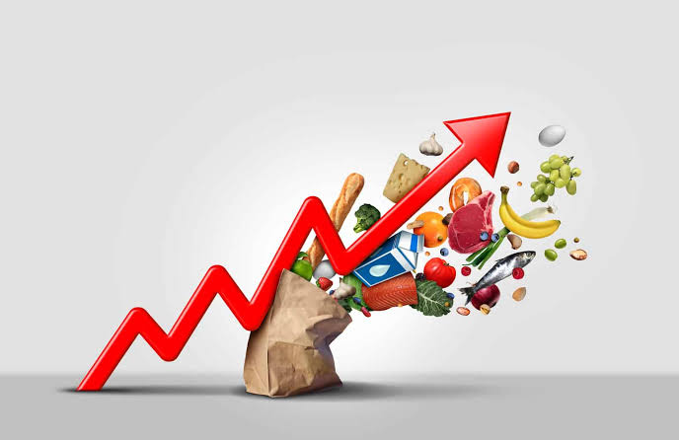
On Rising inflation in Nigeria
Chukwuka Onyekwena
Executive Directior, CSEA
C

Slide 2
Outline
Background
Types of Inflation: Demand-Pull Inflation; Cost-Push Inflation
Rising prices across the globe
Africa and Inflation
Inflation – The Nigerian case
Drivers of Inflation: Exchange rate management, Energy & Transport, Monetary Policy, Boarder closure & Insecurity
Implications of Inflation
Policy Options for Nigeria

Slide 3
Background
The general rise in the price level, known as Inflation, has reemerged as major challenge on a global scale.
Inflation as measured by the Consumer Price Index (CPI) has soared globally.
A major macroeconomic objective of an economy is to achieve stable prices – primary mandate of central banks.
Inflation diminishes the value of money and savings, and therefore decreases purchasing power and the standard of living.

Slide 4
Demand-Pull Inflation
LRAS
Demand-pull inflation is the tendency for prices to increase due to increasing aggregate demand. This type of inflation is usually associated with a strong economy.
There is always a positive output gap whenever a demand-pull inflation occurs).
LRAS
SRAS
SRAS
P2
P2
P1
P1
AD2
AD2
AD
AD
AD1
AD1
Y* Y1
Y* Y1

Slide 5
Cost-Push Inflation
Cost-push inflation is a condition when the supply of goods or services (Aggregate Supply) is limited but demand (Aggregate Demand) remains the same, pushing up prices.
For example, a shortage in the factors of production (labor, natural resources, capital good, etc.) leads to decreased supply of goods and services. While demand remains constant, the prices of commodities increase causing a rise in the overall price level. Nigeria’s inflation follows the cost-push trajectory.
There is always a negative output gap whenever a cost-push inflation occurs).
A good example is the global oil supply shock consequent to the Russia-Ukraine Conflict.
SRAS2
LRAS
SRAS1
P2
P1
AD
AD
Y1 Y*

Slide 6
Rising prices across the globe
Global dimension: Price swings in energy and commodity prices
Prior to the Russia-Ukraine war, inflationary pressures were evident in many economies due to SS-DD imbalances and policy support provided during the pandemic – resulted in a tightening of monetary policy (IMF – WEO, 2022)
The Russia-Ukraine war has triggered supply shocks (oil, gas, metals, wheat & corn). Resulting a significant rise in energy and commodity prices across the globe. More inflationary pressures!
IMF has downgraded its economic growth forecast for 2022 and 2023 to 3.6 percent.
Negative consequences for low-income countries in Africa battling with socioeconomic challenges.

Slide 7
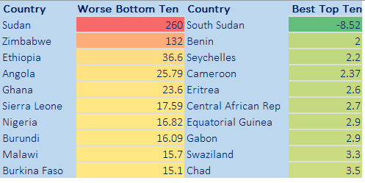
Africa and Inflation
Theoretical, inflation is a monetary phenomenon, such that it increases with an increase in money supply and reduced with a reduction in money supply.
Evidence from Africa shows that beyond monetary factors, structural factors such as supply bottlenecks, over reliance on import, inadequate infrastructure, and weak domestic currency had contributed in part to the high inflation.

Slide 8
Inflation – The Nigerian Case
Nigeria's annual inflation rate recently increased for the third month in a row, to 16.82 percent in April 2022, up from 15.92 percent the previous month driven by food and non-food prices.
Nigeria is dealing with rising food prices; the economy remains heavily reliant on agricultural imports. In addition, rising diesel prices, insecurity, and the ongoing dollar shortage all contributed uptrend in inflationary pressure.
The inflationary episode intensified after the border closure in 2019. The disproportionate impact of inflation on vulnerable households and those working in sectors with low savings, such as agriculture, have worsen living standard over time.

Slide 9
Inflation – The Nigerian Case
Inflation rate, January 2017 to March 2022.
Rate of changes in price level between January 2016 and February 2022

Slide 10
Drivers of Inflation in Nigeria
Inflation
Exchange Rate Management
Energy and Transport
Border Closure and Insecurity
Monetary Policy

Slide 11
Exchange Rate Management
The exchange rate mismanagement has contributed to the rise in inflationary pressure in Nigeria. The chart suggests that the exchange rate depreciation is the propeller for the rise in the imported food inflation, which is a component of the overall inflation rate. The constant depreciation of Naira contributes to the rise in imported food inflation.
Also, the inability of businesses to access foreign exchange through the official exchange-rate window have caused businesses to seek foreign exchange on the parallel market and other alternative sources. The parallel rate influences their business decisions, and fluctuations in the parallel rate pass through to market prices for goods and services.

Slide 12
Energy and Transport
The rising costs of energy (electricity and fuel) and transport are another contributing factor to high inflation in Nigeria. Recent fuel scarcity and poor road infrastructure are the key factors driving energy and transport cost. The chart below portrays that the cost of energy and transportation proportionately effects the overall inflation rate.

Slide 13
Monetary Policy
The chart indicates that the Monetary Policy Rate (MPR) is largely expansionary in nature, which is mostly in response to weak economic growth, and moderate effect on inflation. However, money supply growth corresponds with changes in inflation indicating the sensitive nature of inflation rate to changes in money supply growth.

Slide 14
Border Closure and Insecurity
In August 2019, the Nigerian government closed its land borders. This was a policy aimed at reducing cross-border trade and preventing the smuggling of mainly agricultural products into the country.
While the policy appeared positive in some ways, the subsequent chain of reaction in the economy was negative. Most farmers were constrained in terms of their productivity and increasing production in the short run was nearly impossible. This led to excess demand, constrained supply and inflationary pressure.
The food insecurity emanated from border closure was further exacerbated by regional insecurity in food-producing areas (Boko Haram, Bandits and Unknown Gunmen attacks).
The insecurity situation especially in the Northern Nigeria have destroyed crops and forced farmers to abandon their land. Reduced food production exerts a cost-push impact on food prices.

Slide 15
Implications of Inflation
The immediate direct effect of high inflation is reduction in purchasing power of Nigerians. Given that between 2016 and 2021, price level has increased by about 126 percent, it implies that cost of living had doubled within five years.
Without corresponding increase in income, high inflation pushes people slight above the poverty line into poverty, especially food poverty. While Nigeria has about 80 million poor people, the high inflation is expected to have increase the number of poor people.
In addition to poverty, high inflation through reduction in purchasing power is likely to contribute to high youth crime rate, which would further exacerbate the insecurity conditions in the country.

Slide 16
Policy Options for Nigeria
Monetary tightening – Managing the tradeoff between providing post-pandemic policy support and rising inflation. As the CBN continues to disburse funds to support agriculture, manufacturing, health sector, etc., in an effort to boost domestic production and ease the import demand, raising the monetary policy rate (MPR) rate remains the feasible option in the short term. Long run options should involve tackling the persistent structural drivers of inflation.
Tackle insecurity- Concerted efforts should be made to tackle insecurity which continues to pose supply constraints on food products, particularly across the Northern parts of Nigeria. Community approaches towards improving security can be explored.
Development of transport Infrastructure – The ongoing development of rail transport infrastructure needs to be up-scaled to facilitate the movement of goods across the country and beyond. With the implementation on the AfCFTA, improving cross-border transport infrastructure can facilitate inter-African trade, which can reduce the inflationary pressure on food prices.
Economic diversification: There is need to take concrete and practical steps towards economic diversification, in order to exploit productive capacities and reduce import dependence.

Slide 17
Thank You

